Slide 1
TM352: Using the Chrome Debugger
Chris Thomson April 2018

Slide 2
Getting started
This method will work with both the local (default) emulator or a device
I’ve not tried with with any other emulator (yet)
Your experience maybe better with a device as the map plugin seems to not work well in the emulator.

Slide 3
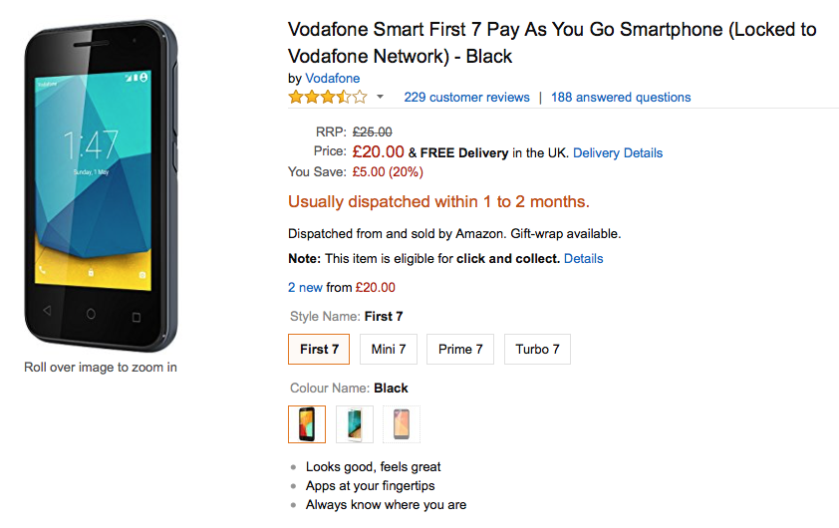
Possible device
I’m using one of these.

Slide 4
Open the debugger
Start the app either in the emulator or the device
e.g. cordova run
Make sure your phone is connected to your PC and debugging is enabled
Start chrome
Go to: chrome://inspect
Select inspect on your device and app (ensure you selected it in usb debugging settings (see screenshot)
https://developers.google.com/web/tools/chrome-devtools/remote-debugging/

Slide 5
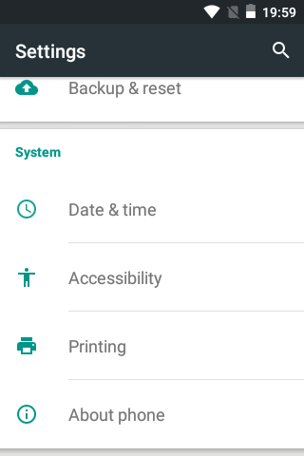
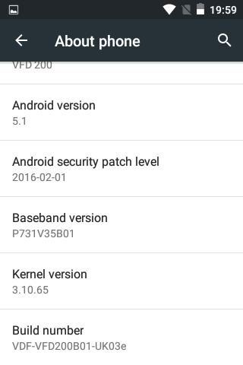
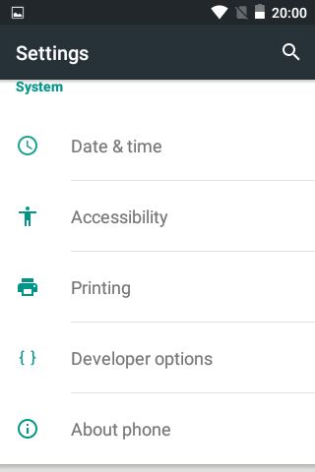
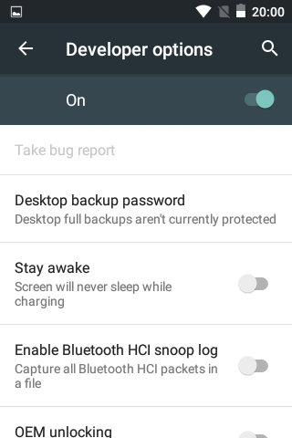
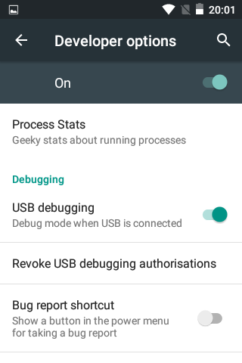
Enable debugging
← No developer options?
← Click here
← Click here
← Click here
← Tap 10 times

Slide 6
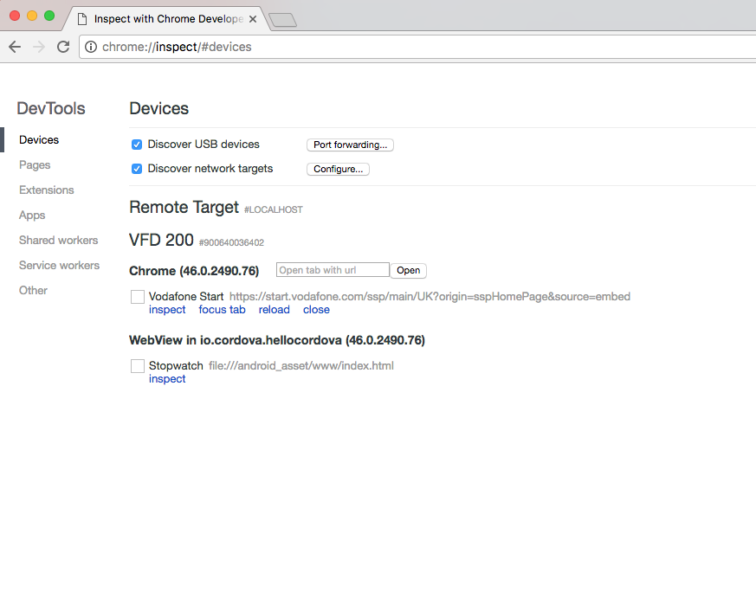
← This one, click inspect

Slide 7
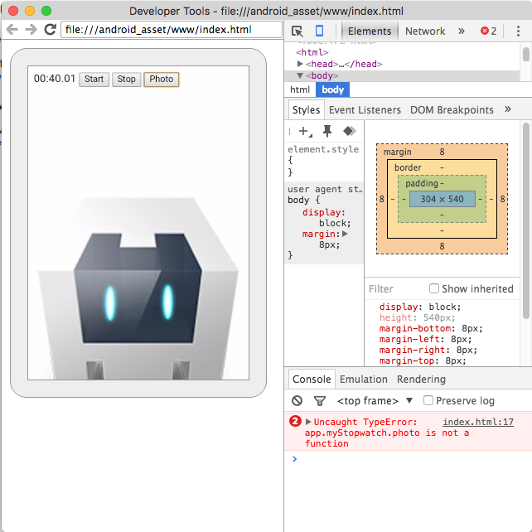
← Note error log
This is actually running on the phone!!!!

Slide 8
Using the debugger
If you have used a debugger before, then this should be similar
Also see guide below
Note if the code does not load, it means you have a syntax error (see the console) log. Fix the syntax error to make the code load (normally a misplaced bracket).
https://developers.google.com/web/tools/chrome-devtools/javascript/

Slide 9
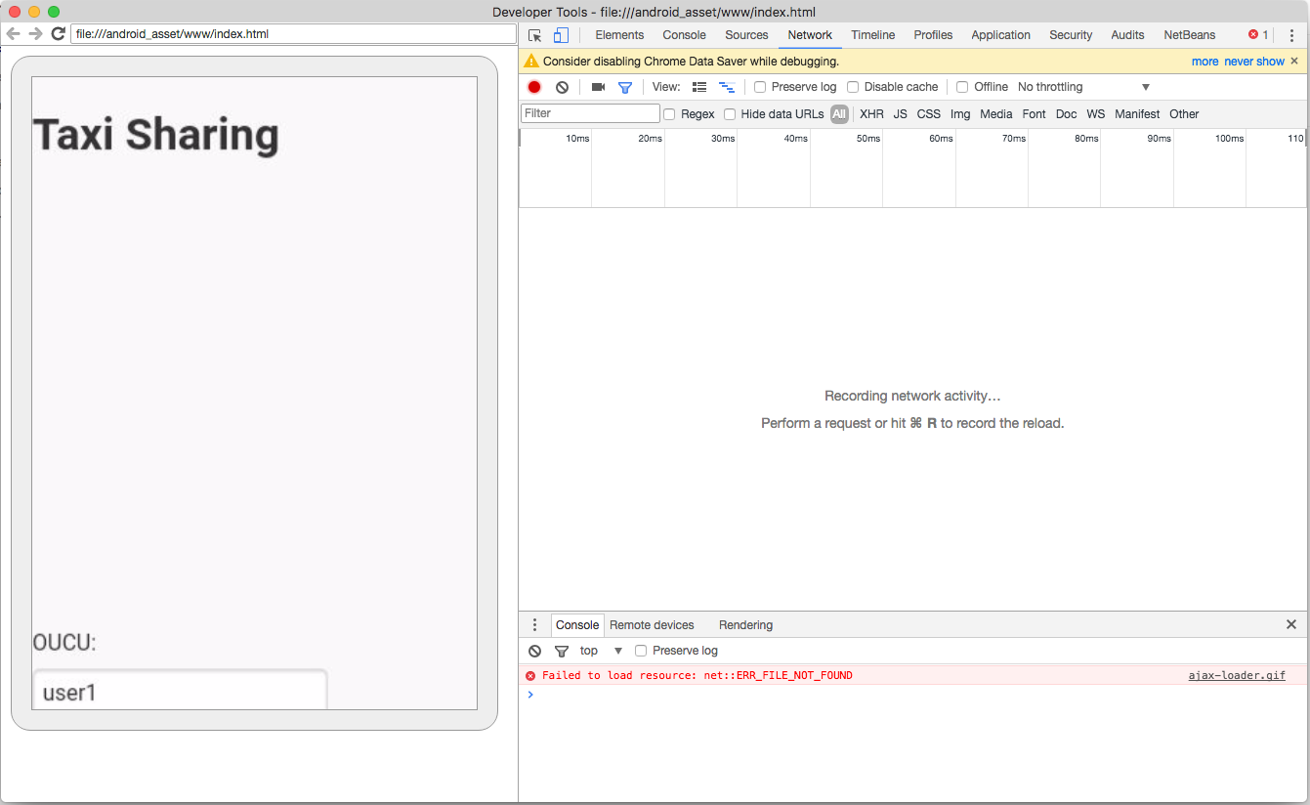
← Click here

Slide 10
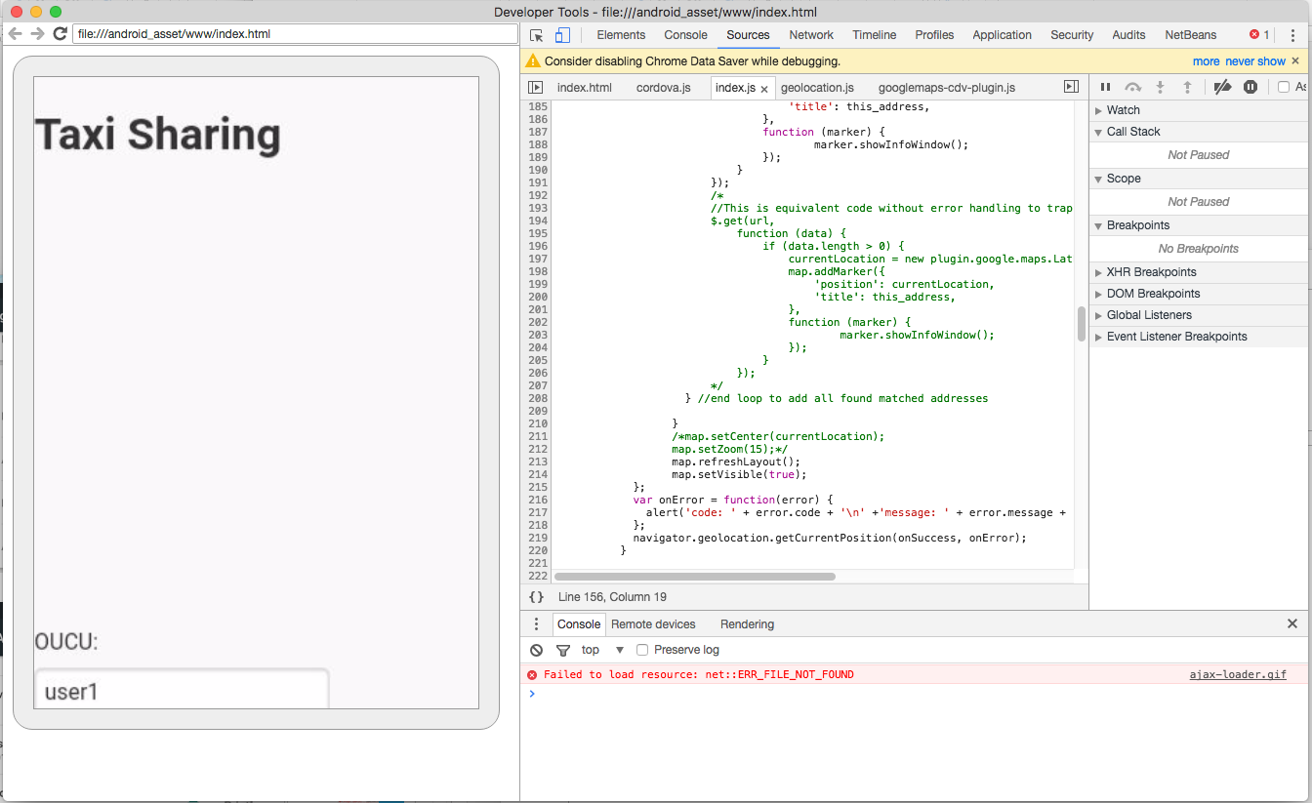
← Click here
Check errors, clear any to do
with parsing
Note different files may appear in your debugger, also if the js file was not parsed it will not show

Slide 11
Break points
These are places where you want the code to stop running so you can check what is happening.
You can set them on any executable line of JavaScript.
You can set as many as you want!

Slide 12
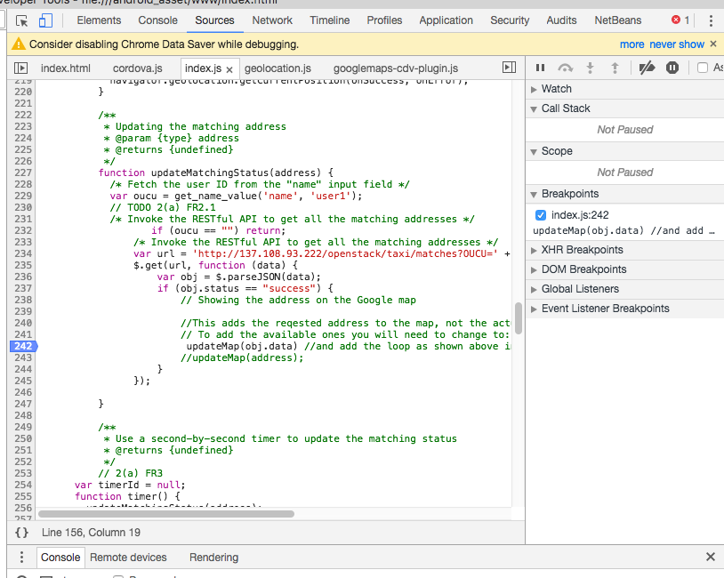
← Click on line number to set a break point

Slide 13
Make the app run
Use the app, click on register and then request, and wait watching the debugger
The app will pause, and the you can check current variables or step through execution

Slide 14
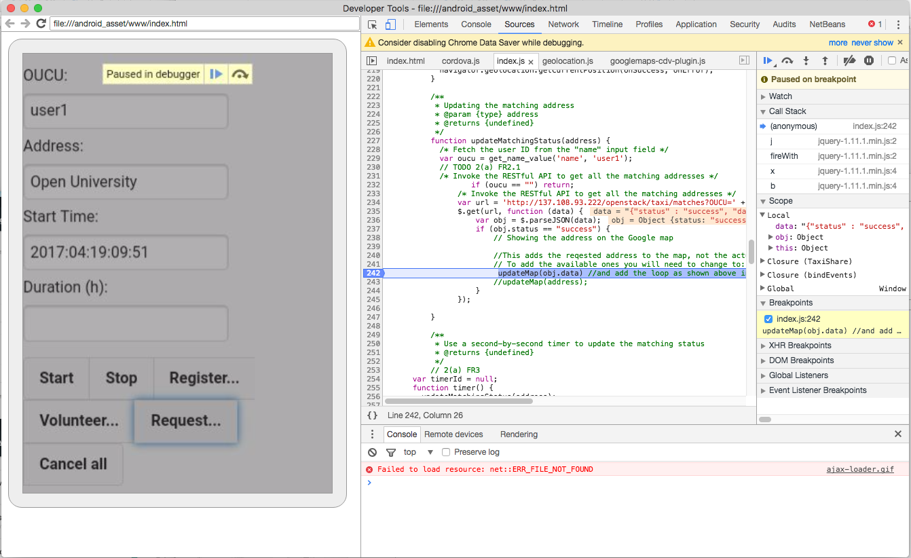
← App paused
← Note blue bar over line shows the next line to
be run

Slide 15
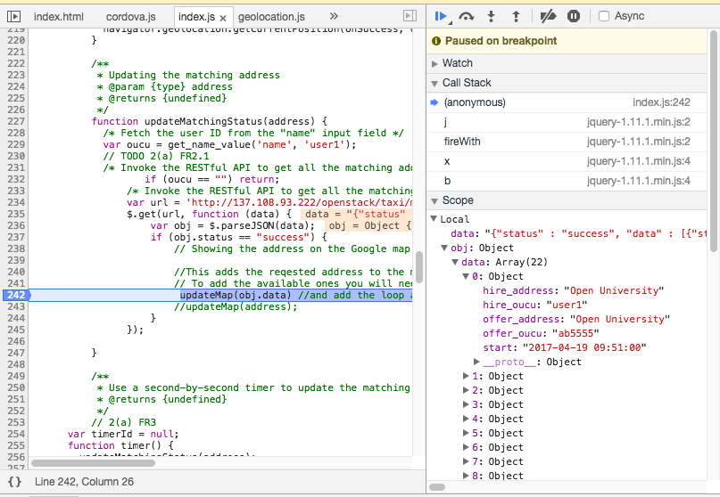
← Explore variable values

Slide 16

← Click here to step out of the current function to its calling fucntion
← Click here to step into a function which is called
← Click here to start the app running again
← Click here to go to the next line

Slide 17
Experiment with the code
I suggest you first experiment with the code I have supplied, as it is known working.
Then play with your code.
If in your code no breakpoints ever trigger, it maybe because you have not set the onClick methods correctly in the HTML file.

Slide 18
Recommended development cycle
Work on one function at a time,
Add a couple of lines at a time,
Make use of Alert calls so you know what your code is doing,
Code and test or run in the debugger, make sure it works before you look at the next thing,
Leave adding the map until last as this seems to be problematic.

Slide 19
For the EMA
I recommend starting with a working JavaScript file, and modifying it to meet the requirements of the the EMA.
You may find starting with the outline from the TMA helpful if you have also followed my notes which explained why some of it works and how.

